Slide 1

AI HEALTHCARE CHATBOT WEBSITE USING DJANGO
DEPARTMENT OF COMPUTER SCIENCE AND ENGINEERING
BATCH NO : 09
REVIEW : 02
Under the Esteemed Guidance of
Mr. P. SASI KUMAR, M. Tech., (Ph.D.)
Assistant Professor.
TEAM MEMBERS
T.N.L. KRISHNA - 20T91A0595
S. SUPRIYA RAVIKUMAR - 20T91A0577
V. SHYAM - 20T91A0597
K. PRADEEP - 21T95A0517
GIET ENGINEERING COLLEGE
Accredited by NAAC, Affiliated to JNTUK, Kakinada, Chaitanya Knowledge
City, Velugubanda, Rajamahendravaram-533296,Andra Pradesh, India.
2023-2024

Slide 2
AI HEALTHCARE CHATBOT WEBSITE USING DJANGO

Slide 3
INDEX
ABSTRACT
INTRODUCTION
EXISTING SYSTEM
LIMITATIONS
PROPOSED SYSTEM
ADVANTAGES
REQUIREMENTS
MODULES
SYSTEM DESIGN
CONCLUSION
REFERENCE

Slide 4
ABSTRACT
With the increasing population of India and a rise in birth rates coupled with advancements in the medical field leading to a decrease in death rates, there is a concerning shortage of doctors to adequately serve the growing population.
This issue becomes apparent when visiting government hospitals in cities, where the limited availability of doctors is a major cause of inadequate treatment and, in some cases, even resulting in patient deaths. Furthermore, doctors, being human, are prone to making mistakes in providing accurate treatments, which can also lead to patient fatalities.
To address such situations, the development of an intelligent and smart chat bot that can offer advice to both doctors and patients becomes crucial, potentially saving the lives of hundreds of people. Virtual assistants, including chat bots, have the potential to assist patients and healthcare providers with various medical-related tasks.
Chat bots are computer programs designed to engage in conversations with individuals, offering assistance through text messages, applications, or instant messaging.

Slide 5
INTRODUCTION
Nowadays, chat bots are becoming increasingly prevalent in various industries, such as IRCTC, banks, and online travel companies like Make My Trip.
With the ongoing trend of digitalization, the demand for chat bots in the market continues to grow. One of the main reasons behind the need for medical chat bots in the healthcare industry is the rising population in India and the scarcity of doctors to cater to the needs of this growing population.
Additionally, even doctors can make mistakes when diagnosing patients, potentially endangering their lives.
For instance, Mohammed Benaziza, a renowned bodybuilder in the 1990s, tragically died due to Hypokalaemia (high potassium level) in his body. He experienced body cramps as a result of this excess potassium, but doctors mistakenly concluded that he was potassium deficient and administered additional potassium, leading to the cramps spreading to his heart and causing his death.

Slide 6
EXISTING SYSTEM
The existing system for a healthcare chatbot incorporates blockchain technology and data analysis.
This system aims to enhance the security, privacy, and integrity of healthcare data, while also leveraging data analysis techniques to provide valuable insights.
Improve the overall patient experience.
This is more costly to use and time taking process.
It can use by multiple authorizations.

Slide 7
LIMITATIONS
Complex user interface. Making user difficult to recognize the operations
Late response to user due to highly dumped data set
More processing time to process huge data

Slide 8
PROPOSED METHOD
The proposed system for a healthcare chatbot integrates Natural Language Processing (NLP) techniques, Decision Trees, and Support Vector Machines (SVM) to create an advanced and intelligent healthcare chatbot solution.
The chatbot utilizes NLP algorithms to understand and interpret user queries or messages in a natural language format.
NLP allows the chat bot to extract relevant information, such as symptoms, medical history, or specific concerns from the user's input.
By applying NLP techniques, the chatbot can comprehend and respond effectively to a wide range of user queries, facilitating a more interactive and personalized conversation.

Slide 9
ADVANTAGES
More visually pleasing
Less response time to user
Simple data set
Less processing times.

Slide 10
HARDWARE & SOFTWARE REQUIREMENTS
SOFTWARE REQUIREMENS
Operating System : Windows 7/8/10
Server side Script : HTML, CSS, Bootstrap & JS
Programming Language : Python
Libraries : Flask, Pandas, Mysql.connector, Os, Smtplib, Numpy
IDE/Workbench : PyCharm

Slide 11
HARDWARE & SOFTWARE REQUIREMENTS
SOFTWARE REQUIREMENS
Technology : Python 3.6+
Server Deployment : Xampp Server
Database : MySQL

Slide 12
HARDWARE & SOFTWARE REQUIREMENTS
HARDWARE REQUIREMENTS
Processor - I3/Intel Processor
RAM - 8GB
Hard Disk - 128 GB
Key Board - Standard Windows Keyboard
Mouse - Two or Three Button Mouse
Monitor - Any

Slide 13
MODULES
1. System
1.1 Take Data: System will receive data from the user.
1.2 Pre-processing: The system will undergo for pre-processing.
1.3 Training: The System will be trained.
1.4 Model: The system will work based on model.
1.5 Results: The system will deliver the output to the user.
2. User
2.1 Send Query: User will send Query to the system.
2.2 View Query Result: User will view his query result.

Slide 14
UML DIAGRAMS
Use Case Diagram:
A use case diagram in the Unified Modeling Language (UML) is a type of behavioral diagram defined by and created from a Use-case analysis. Its purpose is to present a graphical overview of the functionality provided by a system in terms of actors, their goals (represented as use cases), and any dependencies between those use cases. The main purpose of a use case diagram is to show what system functions are performed for which actor. Roles of the actors in the system can be depicted.

Slide 15
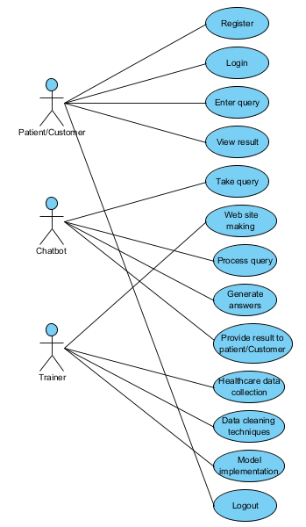
UML DIAGRAMS
Figure: Use Case Diagram

Slide 16
UML DIAGRAMS
Class Diagram:
In software engineering, a class diagram in the Unified Modelling Language (UML) is a type of static structure diagram that describes the structure of a system by showing the system's classes, their attributes, operations (or methods), and the relationships among the classes. It explains which class contains information.

Slide 17
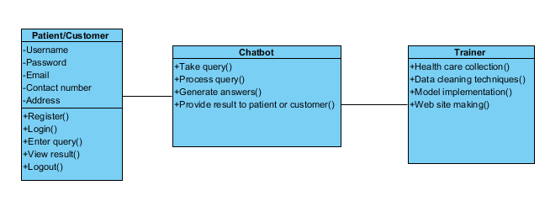
UML DIAGRAMS
Figure: Class diagram

Slide 18
UML DIAGRAMS
Sequence Diagram:
A sequence diagram in Unified Modelling Language (UML) is a kind of interaction diagram that shows how processes operate with one another and in what order. It is a construct of a Message Sequence Chart. Sequence diagrams are sometimes called event diagrams, event scenarios, and timing diagrams.

Slide 19
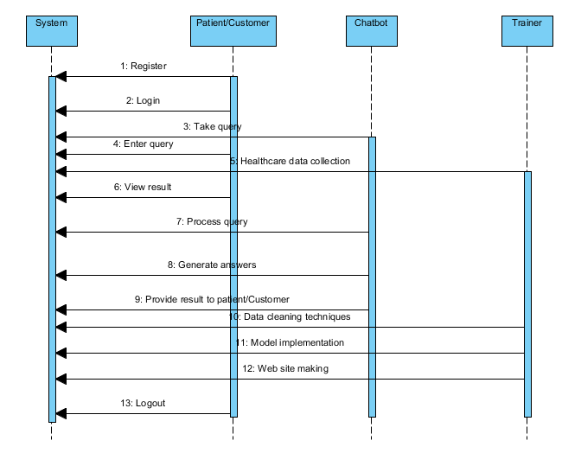
UML DIAGRAMS
Figure: Sequence diagram

Slide 20
UML DIAGRAMS
Collaboration Diagram:
In collaboration diagram the method call sequence is indicated by some numbering technique as shown below. The number indicates how the methods are called one after another. We have taken the same order management system to describe the collaboration diagram. The method calls are similar to that of a sequence diagram. But the difference is that the sequence diagram does not describe the object organization whereas the collaboration diagram shows the object organization.

Slide 21
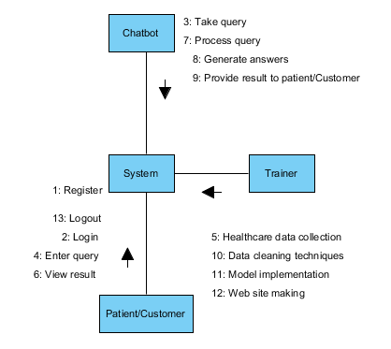
UML DIAGRAMS
Figure: Collaboration diagram

Slide 22
UML DIAGRAMS
Deployment Diagram
Deployment diagram represents the deployment view of a system. It is related to the component diagram. Because the components are deployed using the deployment diagrams. A deployment diagram consists of nodes. Nodes are nothing but physical hardware’s used to deploy the application.

Slide 23
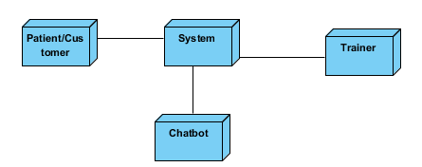
UML DIAGRAMS
Figure: Deployment diagram

Slide 24
UML DIAGRAMS
Activity Diagram:
Activity diagrams are graphical representations of workflows of stepwise activities and actions with support for choice, iteration and concurrency. In the Unified Modelling Language, activity diagrams can be used to describe the business and operational step-by-step workflows of components in a system. An activity diagram shows the overall flow of control.

Slide 25
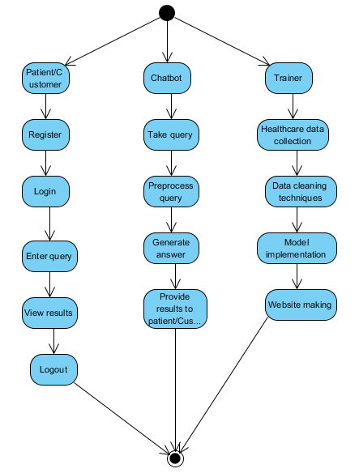
UML DIAGRAMS
Figure: Activity diagram

Slide 26
UML DIAGRAMS
Component Diagram:
A component diagram, also known as a UML component diagram, describes the organization and wiring of the physical components in a system. Component diagrams are often drawn to help model implementation details and double-check that every aspect of the system's required functions is covered by planned development.

Slide 27
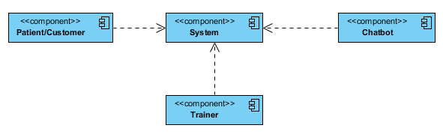
UML DIAGRAMS
Figure: Component diagram

Slide 28
UML DIAGRAMS
ER Diagram:
An Entity–relationship model (ER model) describes the structure of a database with the help of a diagram, which is known as Entity Relationship Diagram (ER Diagram). An ER model is a design or blueprint of a database that can later be implemented as a database. The main components of E-R model are: entity set and relationship set.
An ER diagram shows the relationship among entity sets. An entity set is a group of similar entities and these entities can have attributes. In terms of DBMS, an entity is a table or attribute of a table in database, so by showing relationship among tables and their attributes, ER diagram shows the complete logical structure of a database. Let’s have a look at a simple ER diagram to understand this concept.

Slide 29
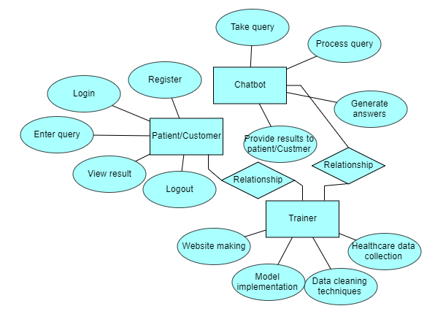
UML DIAGRAMS
Figure: ER diagram

Slide 30
UML DIAGRAMS
DFD Diagram:
A Data Flow Diagram (DFD) is a traditional way to visualize the information flows within a system. A neat and clear DFD can depict a good amount of the system requirements graphically. It can be manual, automated, or a combination of both. It shows how information enters and leaves the system, what changes the information and where information is stored. The purpose of a DFD is to show the scope and boundaries of a system as a whole. It may be used as a communications tool between a systems analyst and any person who plays a part in the system that acts as the starting point for redesigning a system.

Slide 31
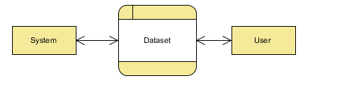
UML DIAGRAMS
Figure: Context Level diagram

Slide 32
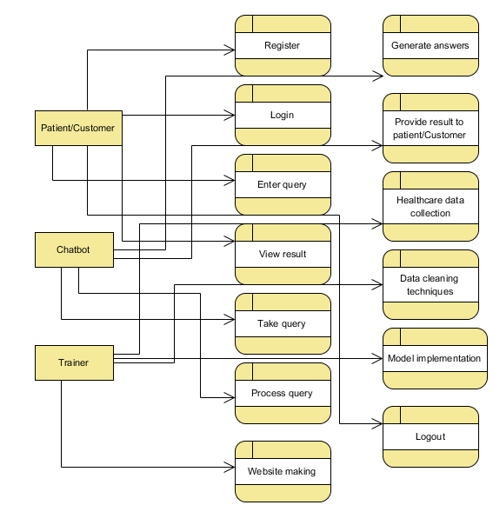
UML DIAGRAMS
FigureLevel-1 diagram

Slide 33
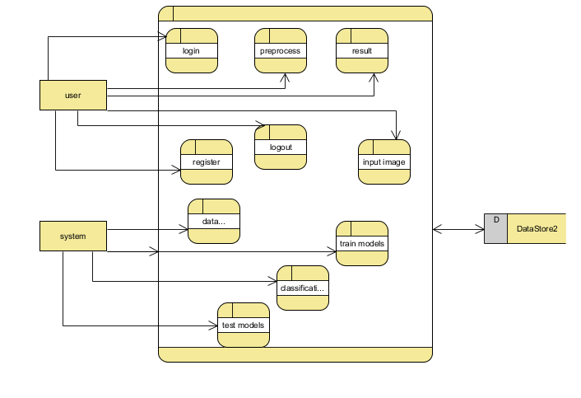
UML DIAGRAMS
Figure:Level-2 diagram

Slide 34
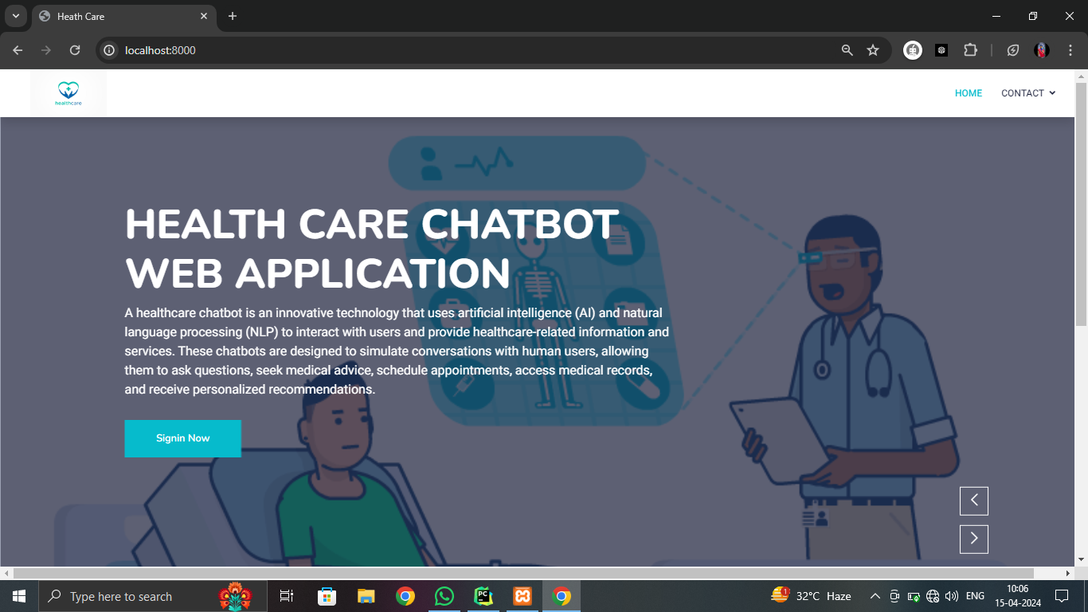
OUTPUT SCREENS

Slide 35
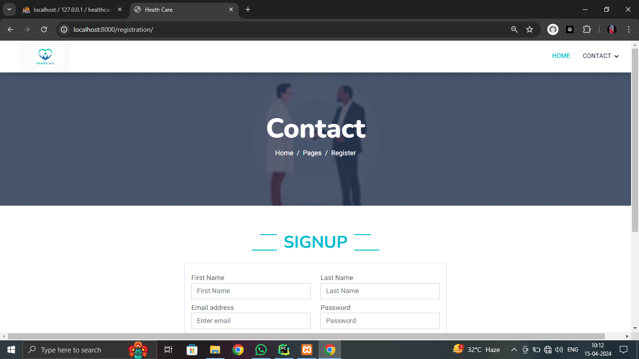

Slide 36
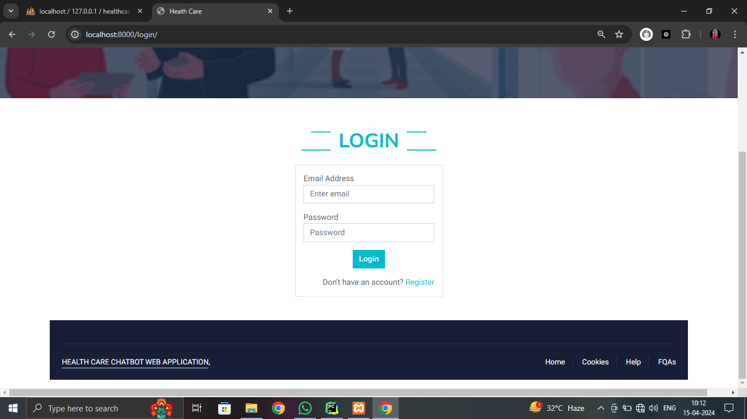

Slide 37
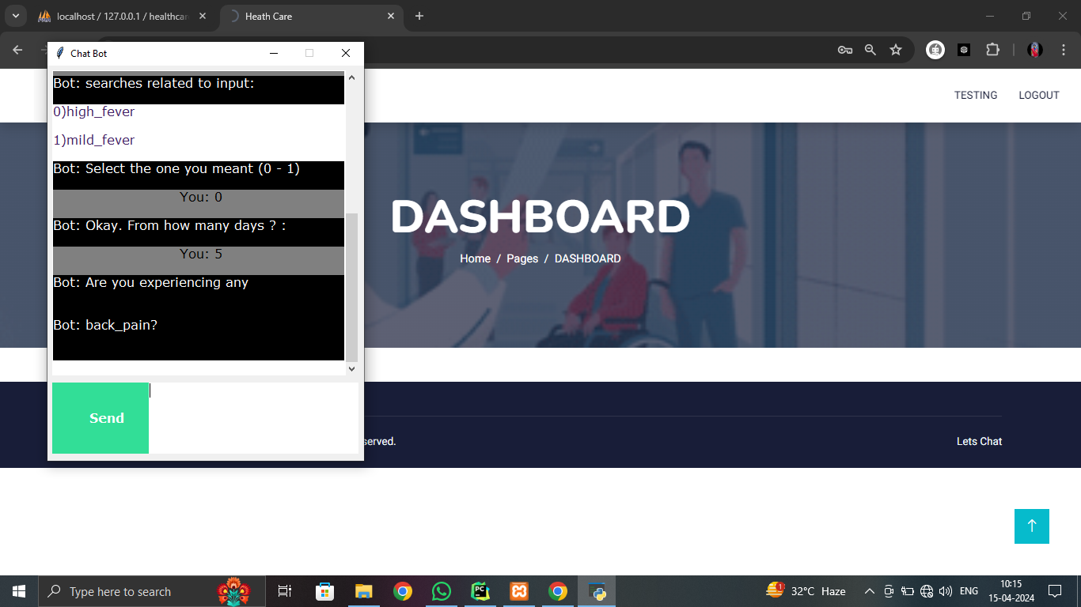

Slide 38
CONCLUSION
The AI Healthcare Chatbot website using Django was chosen to revolutionize healthcare interactions.
By integrating artificial intelligence, the chatbot offers instant, personalized medical guidance, enhancing patient engagement and accessibility.
This innovative solution aims to streamline communication, provide timely health advice, and facilitate appointment scheduling.
The project aligns with the growing demand for efficient, patient-centric healthcare services, leveraging technology to bridge gaps, improve healthcare accessibility, and offer a user-friendly interface for seamless interaction between patients and medical resources.
By leveraging Django for the development of an AI healthcare chatbot website, developers can create a robust, scalable, and secure platform that provides valuable healthcare services to patients while maintaining compliance with industry regulations.

Slide 39
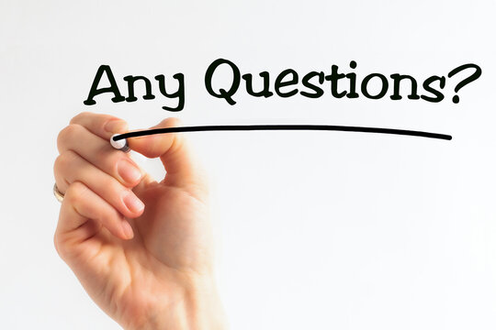

Slide 40
REFERENCES
[1] A. Allen, ‘‘Morphing telemedicine-telecare-telehealth-ehealth,’’ Telemed Today, Special, no. 2000, 2000.
[2] S. L. Murphy, J. Xu, K. D. Kochanek, and E. Arias, ‘‘Mortality in the United States, 2017,’’ NCHS Data Brief, no. 328, pp. 1–8, Nov. 2018.
[3] K. Myers, P. Berry, J. Blythe, K. Conley, M. Gervasio, D. L. McGuinness, D. Morley, A. Pfeffer, M. Pollack, and M. Tambe, ‘‘An intelligent personal assistant for task and time management,’’ AI Mag., vol. 28, no. 2, p. 47, 2007.
[4] Flora Amato, Stefano Marrone, “Chatbots meet eHealth: automat zing healthcare”, proceeding of diet, May-2018.
[5] Benilda Eleonor V. Comendador, “Pharmabot: A pediatric generic Medicine consultant Chatbot”, proceeding of the JACE, April 2015.

Slide 41


